Slide 1

CSS
Lesson 14

Slide 2

CSS3 Transforms
A transform is an effect that lets an element change shape, size and position.
2D transforms
translate()
rotate()
scale()
skew()

Slide 3
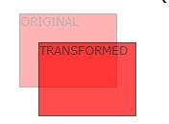

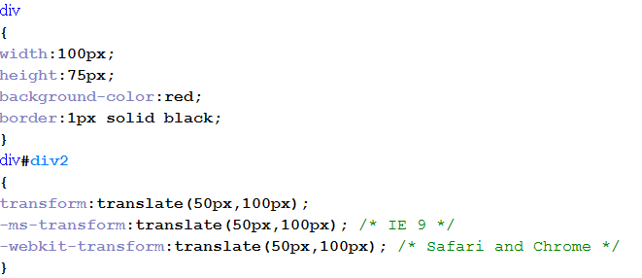
CSS3 Transforms
With the translate() method, the element moves from its current position, depending on the parameters given for the left (X-axis) and the top (Y-axis) position:
2D transforms:translate()

Slide 4
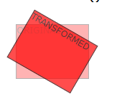
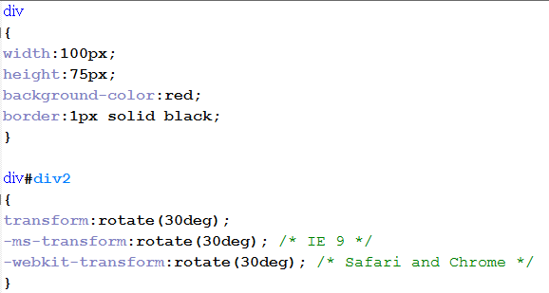
CSS3 Transforms
With the rotate() method, the element rotates clockwise at a given degree. Negative values are allowed and rotates the element counter-clockwise.
2D transforms:rotate()

Slide 5

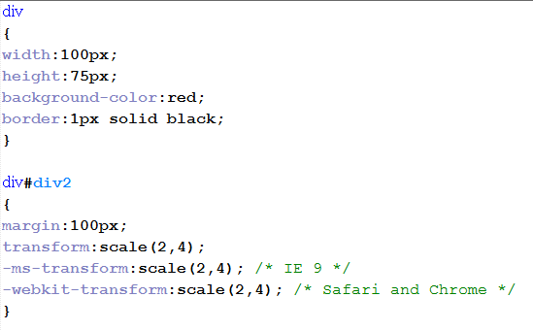
CSS3 Transforms
With the scale() method, the element increases or decreases the size, depending on the parameters given for the width (X-axis) and the height (Y-axis):
2D transforms:scale()

Slide 6
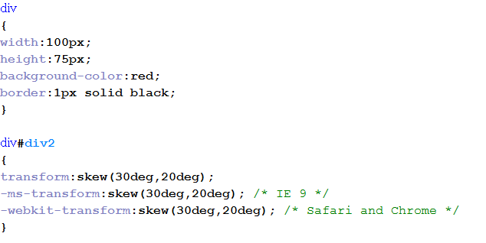
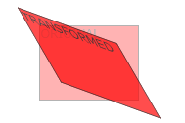
CSS3 Transforms
With the skew() method, the element turns in a given angle, depending on the parameters given for the horizontal (X-axis) and the vertical (Y-axis) lines:
2D transforms:skew()

